Slide 1
IDS 462 Lecture 6
Fall 2008

Slide 2
Memo 3 (Mid Term)
Your client wants to know:
  Can we build a model to cut our mailing quantities by 25% and still get MOST of our responses
  What are the variables in the model
  Which ones are the most impactful and how do they impact the prediction of response
  If I want to cut my mail quantity by a different percent, what would you suggest and what is the affect on the proportion of responses
  These questions are in order of importance and the first one is really the MOST important
  So make sure you answer the first question first and thoroughly

Slide 3
Review Some Concepts
Please don’t forget to write-up YOUR model, not MY model (from last week)
Why do we use the desc or descending option on the proc logistic statement?

Slide 4
Two More Items
How can we avoid having to explain log-odds to a business person who probably doesn’t remember what a logarithm is?
Which model should you use to for your significance tests?

Slide 5
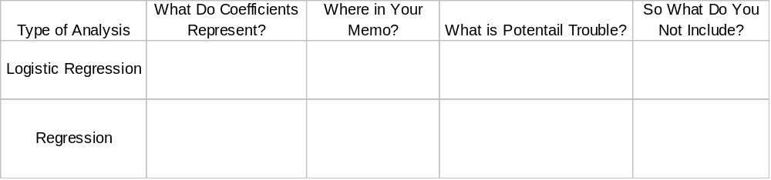
Table for Understanding
If you understand the preceding discussion then you should be able to fill in the table below

Slide 6
Additional Items
What does it mean if Moshoo_10 is in your model?
How do we interpret the regression coefficient for any of the quantitative variables?

Slide 7
Outline for Memo
Let’s make an outline of the memo (Including the technical appendix) on the whiteboard
I will guide, but you will need to participate (heavily)

Slide 8
Logistics for Midterm Memo
I will try to be extra available
We can schedule a help session as possible, if needed
I want you to turn in a memo with the following characteristics
  Business Memo: Forms an argument that your client will understand even though he knows very little about statistics (assume he knows the basics of regression)
  So that after he reads the memo he would say “I will pay your fee for doing this analysis”
  Technical Appendix: Explains what you did with the data so that your boss would say “You did this analysis correctly”
Some of you are just ‘writing up your notes’
I would rather you come see me and work out an extension than just write up your notes because you don’t understand
  Reading a memo that doesn’t form an argument is a waste of my time
Also please remember business format

Slide 9
Background on Neural Nets And Tree Based Methods
Background for Next Project
Complete this as time allows

Slide 10
Source of Competition
I heard Jerome Friedman (Stanford) talk in the late 90’s. He said:
‘There are about as many statisticians graduating today as there were in the 70’s’
‘When a graduate student in statistics gets a good idea he writes his thesis. When a graduate student in computer science gets a good idea he starts a company’

Slide 11
New Vs. Old
Realize that many statistical techniques were invented in the 1940’s-60’s
In those days, having 40 individuals in your dataset was a big number
Today Discover card has more than 40 million account holders
With n’s this large, statistical significance starts to break-down
  Very small differences become statistically significant

Slide 12
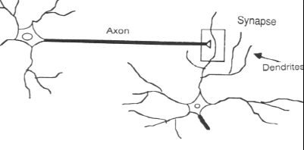
New Methods Pattern Recognition
The computer scientists got in the field by trying to invent a way for computers to recognize patterns
The original thinking was to model the inter-connections used in the human brain

Slide 13
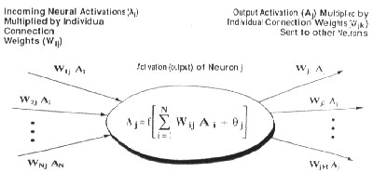
Pattern Recognition
In computers, this took the form of creating nodes, which are mathematical operators
Nodes are connected so that the output from one node is acted upon by another and then sent on to another node

Slide 14
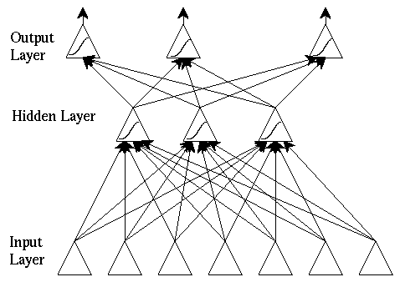
Neural Networks
A considerable number of these nodes are then strung together
The initial input is the set of independent variables and the final output is an estimate for the model (like a regression estimate)

Slide 15
The Market Said: Cool!!
Neural Networks certainly sound very exciting
The original work was trying to mimic the human brain process
Then the marketing took over
  More hype then help
Because really, this is just a form of non-linear modeling
Given enough nodes, a neural network is a universal approximator
  It can learn any pattern, no matter how complex

Slide 16
Learn Any Pattern– What Does That Mean?
This is similar to the idea that if you had one coefficient in your model for every row in your data set, then each coefficient would simply be the value of the dependent variable and you would have perfect fit
Because of their complexity neural nets can achieve this
So the challenge is in limiting the number of nodes and connections so that the net does not OVER-FIT the data
  Over-fitting is a large issue in modeling for business purposes

Slide 17
Neural Nets– Weaknesses
In addition to the over-fitting issue, a weakness of neural networks is that they are not interpretable
The mathematical operator at any one node is highly dependent on the output of other nodes
So the ‘coefficient’ associated with any one node is not directly interpretable
  So we cannot say, as age increases by 1 unit the probability of response increases by .08 units, as we can in regression

Slide 18
Neural Nets– Strengths
The principle strength of neural networks is that they more easily fit data that is non-linear and has more interactions
Neural nets make no assumption that the relationships in the data are linear
  This is also why over-fitting is a big issue with neural nets

Slide 19
Tree Based Methods– CHAID
CHAID stands for Chi-Square Automatic Interaction Detection
In this method, the chi-square statistic is computed between the dependent variable and each (that is all, individually) of the independent variables
The independent variable with the largest chi-square statistic (really, lowest p-value) is selected and the data are split into groups based on that independent variable
Each of these sub-groups is then examined and the process is repeated
See figure on next page

Slide 20
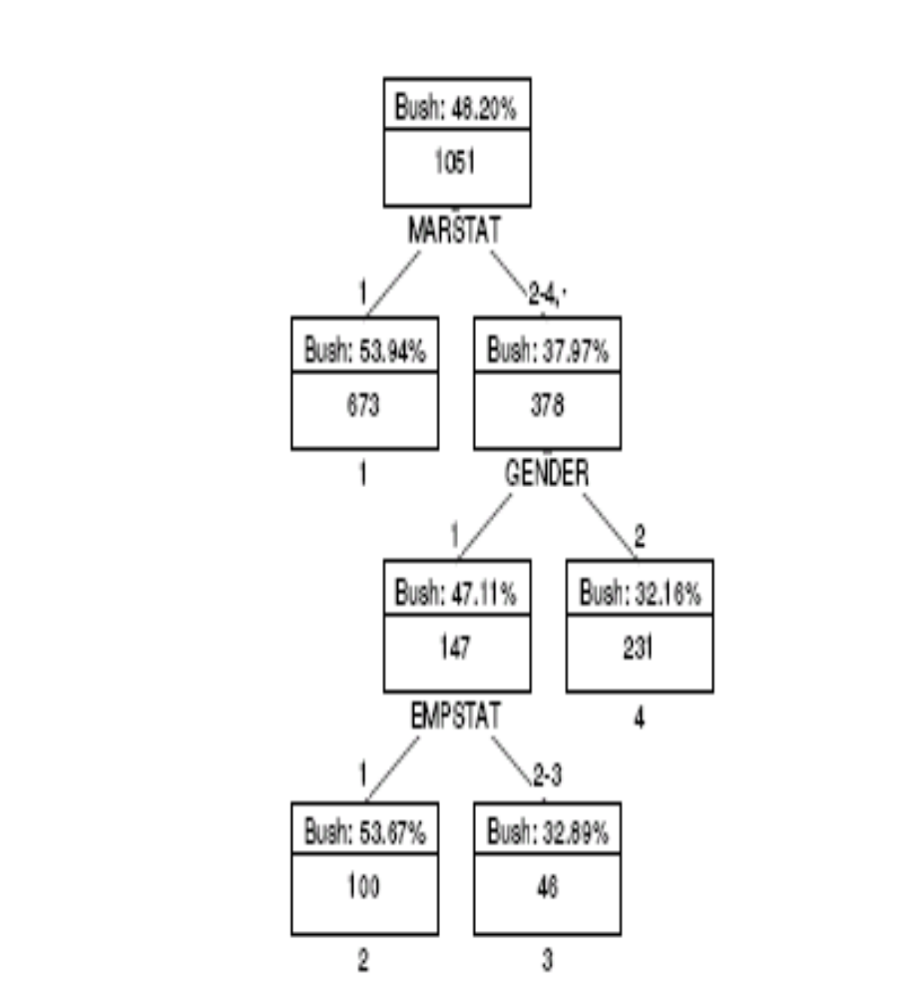
CHAID Example
So the independent variable that created the biggest difference in voting for Bush was Marital Status (marstat)
For marstat 2-4, the biggest splitter was then gender
There was no significant splitter for marstat=1

Slide 21
CHAID Example
Note that different groups can have different subsequent splitting variables
For example, marstat=1 could have been split on something other than gender, although that did not happen here
Thus interactions can take place
  Here the interaction was between marstat and gender to produce a significant split

Slide 22
CHAID Example
The value of the dependent variable in the unique sub-group is the ‘estimate’ produced by the tree for the dependent variable
  So the estimate is 32.89% in terminal node 3 (lower right)

Slide 23
Notes About Trees
There are other types of trees
  CART, QUEST
They can be used for both binary, categorical and quantitative dependent variable

Slide 24
Trees– Strengths & Weaknesses
Strength: Finds interactions more easily
Weakness: Does not use every independent variable to build estimate for the dependent variable
  As logistic regression and Neural Nets do

Slide 25
Next Week– I Will Show Results
I would love to have you run a CHAID tree and a neural net on this data, but the software is not available at the same time that the class meets.
So, I will do a little demo-ing and share results
A comparison of the three models will be the basis of the next memo

Slide 26
Last Topic:
Multiple Response Questions
A common question in surveys is the ‘Check all that apply’ question
Example on page 111 of book: ‘Which course or courses would you like to see offered next semester?’
  Micro Computers
  Intro to SAS
  Advanced SAS
  JCL
  FORTRAN
  PASCAL

Slide 27
How Recorded in Data?
This will commonly be recorded in the data set as Response1, Response2…Response6
So any of the 6 courses can be in any of these 6 ResponseX variables
If we do a proc freq on this, what happens?
We get a count report, but we would then have to add up the counts for Intro to SAS, etc., across the different slots

Slide 28
Get Lecture9Program.sas
What happens if you run the first proc freq
How many students wanted to take Pascal next year?
data MultRespRaw;
infile cards dlm=',' dsd missover;
input gender $ resp1 resp2 resp3 resp4 resp5 resp6;
datalines;
M,1,3,6
F,2,3
M,1,5,6
F,4,5,6
M,5,6
F,6
M,1
F,2,3
M,2
F,4
M,4,5
F,1,2,3
M,1,2,3,4,5,6
F,1,5,6
;
run;
proc freq data=MultRespRaw;
tables resp1--resp6;
run;

Slide 29
Use Arrays to Manage Data
We can make this much more manageable using arrays
data MultRespArray;
set MultRespRaw;
array R[6] Resp1--Resp6;
do i=1 to 6;
resp=r[i];
if r[i] ne . then output;
end;
run;
proc print data=MultRespArray;
run;
proc freq data=MultRespArray;
tables resp;
title "Count Report for Arrayed Multiple Response Question";
run;
title;

Slide 30
Why Bother?
You could just add the numbers up by hand or in a spreadsheet
But what if someone (like a client) asked you whether males were interested in the same courses as females
What is the appropriate statistical test
  We are just looking for the difference between two groups, but the dependent variable is nominal

Slide 31
Statistical Test for Courses
Answer: Chi-Square Test
If the distribution of preferred courses is different for men vs. women, then the p-value for the chisq test on proc freq will be small (smaller than the alpha you are using)
What is the largest assumption or constraint for a chi-square test?

Slide 32
Constraint for Chi-Square
Adequate count for each cell of the cross-tab table (generally greater than 5)
YOU MUST PAY ATTENTION TO THIS CONSTRAINT IN THE HOMEWORK!
If this is not true, then Exact tests can be used
  Exact tests are complicated and
  Can take a lot of computer time, so be careful
For this example, computer time is not a problem

Slide 33
Ugly Output
Take a look at the output window after you run
proc freq data=MultRespArray;
tables resp*gender/chisq exact;
title "Chi-Square Test for Mult Resp Question";
run;
title;
It is WAY ugly!
How get it pretty and into Excel easily?

Slide 34
Save Results to Excel
Run the code at right
Run the proc format first
Results will pop up in an Excel viewer
They should also save to an Excel sheet, but I don’t know where it will save to on lab computers
ods html file='test.xls' style=minimal;
proc freq data=MultRespArray;
tables resp*gender/nocol norow nopercent;
format resp class.;
run;
ods html close;

Slide 35
Getting Rid of Grid
You can get rid of the grid lines by getting the data to Excel and then going to Edit…Clear…Formats

Slide 36
Book Homework
Do problem 3.20 on page 121
Add:
  Perform chi-square test for whether males prefer different composers vs. females
  Check assumptions against any SAS messages
  Use appropriate p-value
  Send output to Excel and turn in that output
  1 or 2 sentence write-up is all that is needed

